Slide 1
DG Interns Hub
Week 1: Networking Fundamentals
Cybersecurity Internship Submitted by: Amar Pratap

Slide 2
OSI Model
Seven-layer reference model
7 Application — network services to applications
6 Presentation — translation, encryption and compression
5 Session — establishes and manages sessions
4 Transport — end-to-end delivery (TCP/UDP)
3 Network — IP addressing and routing
2 Data Link — frames and MAC addresses
1 Physical — bits, signals and media

Slide 3
TCP/IP Model
Four-layer practical protocol architecture
Application — HTTP, HTTPS, FTP, DNS and other application protocols
Transport — TCP and UDP
Internet — IP and routing
Network Access — Ethernet, Wi-Fi and local/physical delivery
OSI mapping: Application/Presentation/Session → Application; Transport → Transport; Network → Internet; Data Link/Physical → Network Access

Slide 4
Network Protocols
HTTP — web communication
HTTPS — secure web communication using TLS
FTP — file transfer between client and server
DNS — resolves domain names to IP addresses
DHCP — automatically provides IP configuration

Slide 5
IP Addressing & Subnetting
IPv4 uses 32 bits and is written as four decimal octets
Private ranges: 10.0.0.0/8, 172.16.0.0/12, 192.168.0.0/16
Public IPs are used for Internet-facing communication
Example subnet: 192.168.1.0/24
Network: 192.168.1.0 | Usable hosts: 192.168.1.1–192.168.1.254 | Broadcast: 192.168.1.255

Slide 6
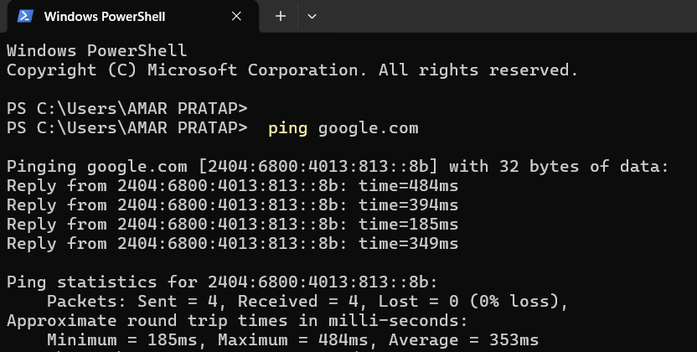
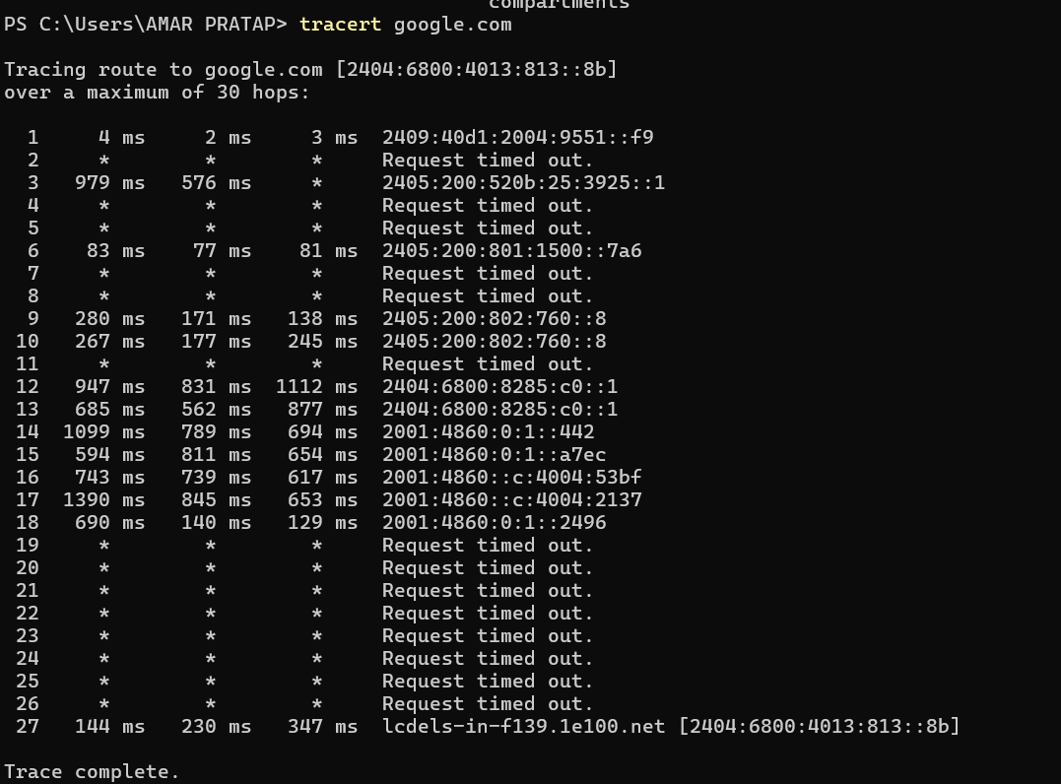
Practical: Windows Network Commands
ping google.com → 4 replies, 0% packet loss in the supplied evidence
tracert google.com → multiple hops; some intermediate timeouts are visible
ipconfig → run the command by itself on Windows

Slide 7
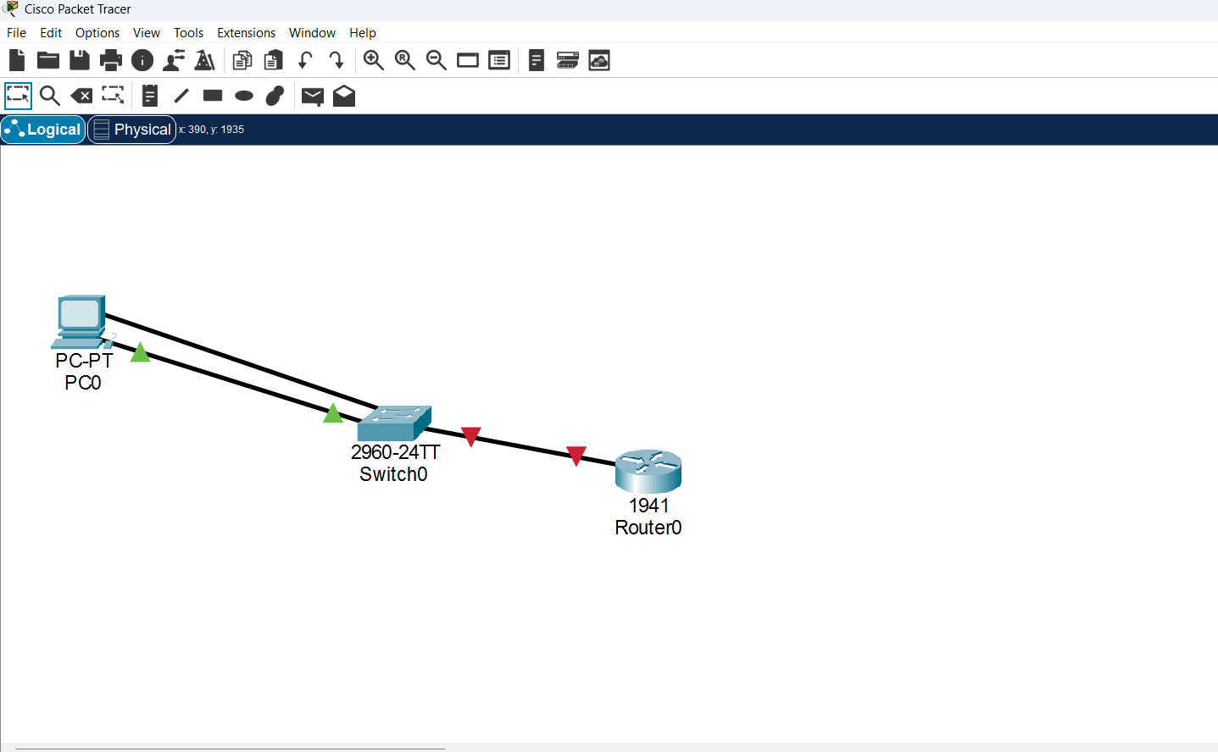
Practical: Cisco Packet Tracer
Topology: PC → 2960 Switch → Cisco 1941 Router
Connection: Copper Straight-Through
PC: 192.168.1.10/24
Router G0/0: 192.168.1.1/24

Slide 8
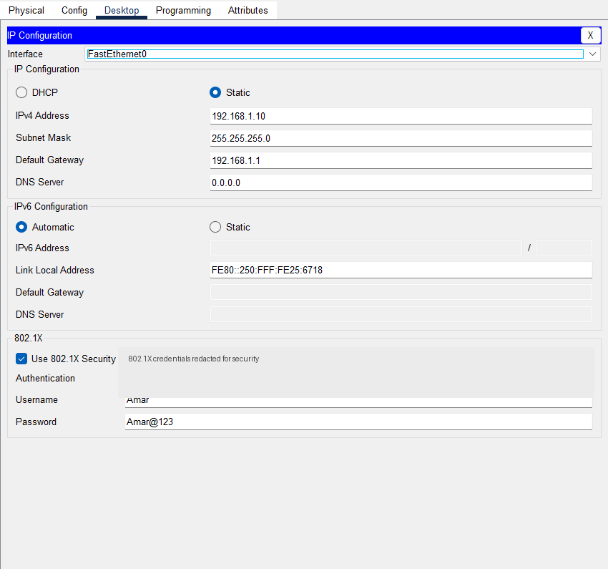
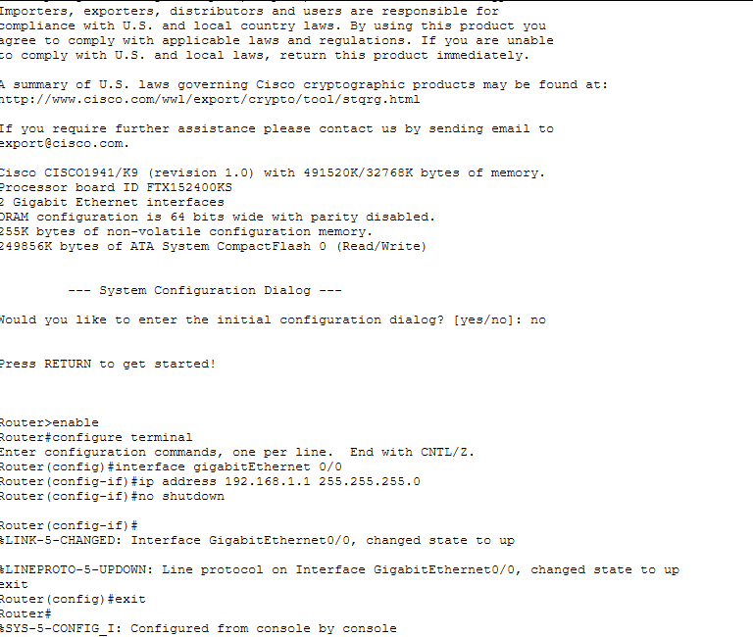
Configuration & Learnings
PC and router IP addresses configured
Router interface enabled with no shutdown
Networking concepts practiced for cybersecurity

